Slide 1

CMSC 137
Data Communications and Networking
Lecture Module
Communications at each layer

Slide 2
Module 100: Communication at each layer
Joseph Anthony C. Hermocilla
Lecturer

Slide 3
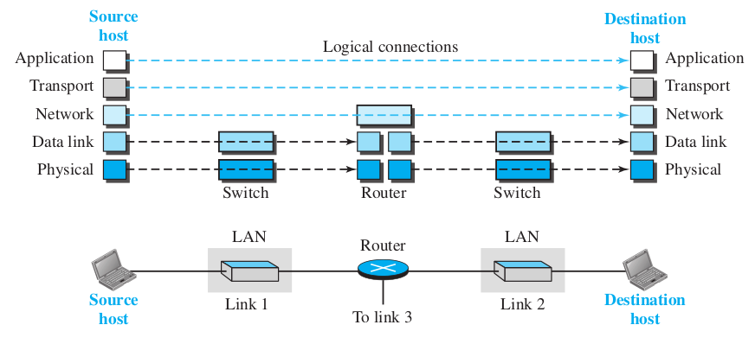
5-Layer TCP/IP Protocol Suite

Slide 4
Example Scenario
Alice of Sky Research would like to order a book from an online bookseller named Bob from Scientific Books
How does the communication happen at each layer?

Slide 5
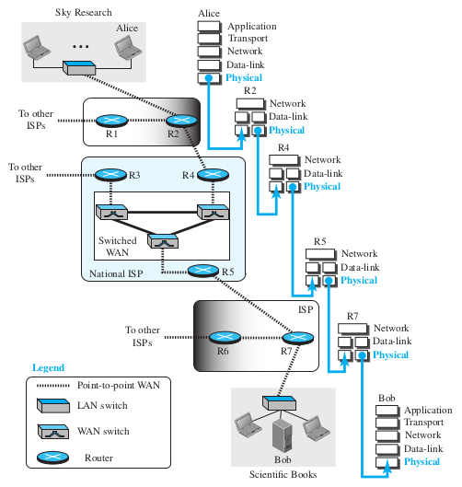
Physical Layer

Slide 6
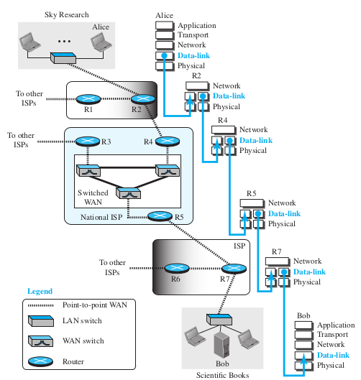
Data Link Layer

Slide 7
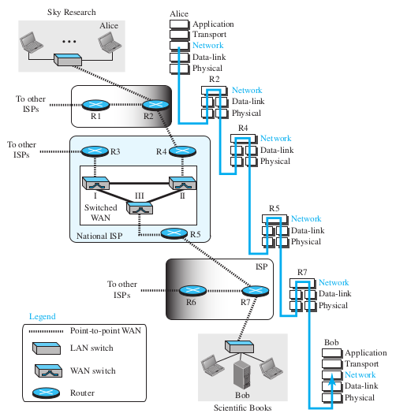
Network Layer

Slide 8
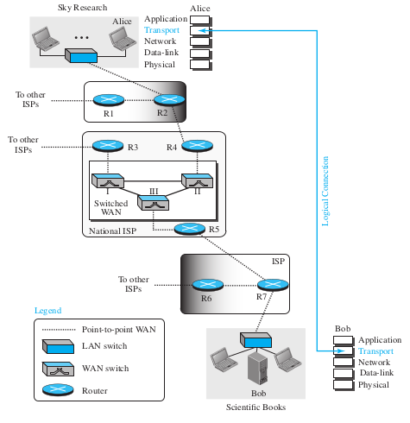
Transport Layer

Slide 9
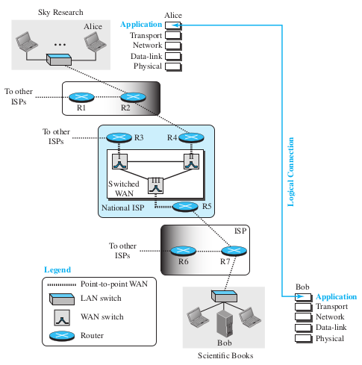
Application Layer

Slide 10
Reference
Forouzan, B.A. 2013. Data Communications and Networking, 5th Ed. McGraw-Hill, New York.

